Slide 1
Writing User Interfaces
for 4 Platforms at Once
for MIT 6.470
January 16, 2013
Dan Mascenik
VP of Engineering
dan.mascenik@appian.com
Notes:
About me:
- I'll talk about Appian later
- Didn't go to MIT, but first software job at software company was full of 6.916 people
- Don't let the VP thing fool you, I still write code (mostly Java backend, plus some GWT and Android)
- But I'll admit you're probably writing a lot more code than me... :-)
I'm going to talk about how to make a website with a mobile app counterpart
- Not just one mobile platform, but 3 or more
- Support for all browsers
- How to do it at the speed of a startup where every minute counts
All this assumes you WANT to have a mobile app counterpart
- Let's start by talking about why you might

Slide 2
Web, Mobile or Both?
software startups live or die by user experience
Notes:
Ok, more plays in... Timing, rich friends... But assuming that's all set...
There are very few radically new ideas out there that succeed as startups
- Most successful startups do something that's already been done - only better
It's mostly variations on the same themes (just 3 themes for 6.470)
- "There's about 1000 apps (or websites) for that..." (most or all suck)
- With IaaS, EC2 you can add 1001st website for cheaper than a pizza
(accountant for corp tax return costs more than startup expenses)
Another challenge - no one wants to think
- Apple has conditioned us well
- You've got about 5 seconds to get users to figure out your site
(Google's got welcome wizards in docs and plus, but only because they're already huge)
Web startups are in what marketers call a "Red Ocean"
- Typically this refers to commodity products that only compete on price, race to the bottom
- But you can't charge anything to get people to try your site - you've already hit rock-bottom on price!
- User experience is really all you've got

Slide 3
Web, Mobile or Both?
people spend a lot of time on mobile devices
Notes:
Chances are, your web app will be accessed via a mobile browser more than non-mobile
- Will it still take 5 seconds to figure out?
- Will it still be useful?
- Will it even work? No hover, no fancy multi-touch or right-click
- Acts like a browser. No offline state, no sync'ing, no native service integration
Plus all the other things mobile deals with:
- not always connected, varying connection speeds
- plenty of opportunities for bad user experience
Lack of a native app is a rule-out for the mostly-mobile crowd
- back to the "red ocean" situation
- 950 of 1000 websites probably have native apps (probably for the platform you don't have)
Successful web apps have to have a mobile counterpart

Slide 4
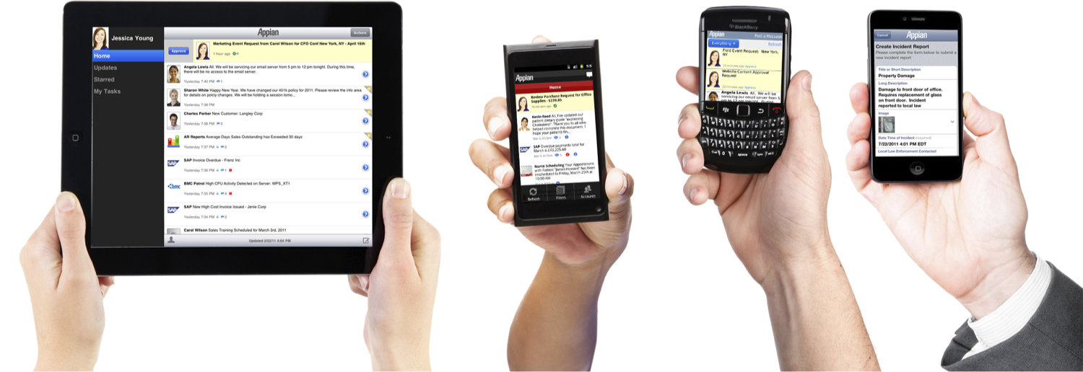
Ok, Both... Which platform?
Notes:
Clearly a dated slide - iPad mini, Galaxy tablet, Kindle Fire, Windows 8, etc.
Which platform is a trick question...
- Sorry, I know the IAP is all about web app development
- Not saying you should have taken 6.570 (they're only doing Android)
- You need to do them ALL!
Startups need to grab as much market share as possible as fast as possible
- Leaving iOS or Android on the table is a huge opportunity for your competitors
- How quickly you can add a new platform (windows 8) could pull your startup ahead
- or be where you start to lose traction to the startup that did it faster
Wouldn't it be great if you could write once, run anywhere?
- But what does this mean for UX?
- Same UX on all platforms? All form factors? (could look weird at best)
But maybe porting is cheap enough
- You've solved all the hard problems
- Just hire someone to translate code from one platform to another

Slide 5
When in Rome...
user experience is best when it's familiar
Notes:
As with everything else, this isn't a new idea
- Desktop apps have been ported to multiple OS platforms for years
But winning with a web app is totally different
- 5 second learning curve
- new startup has no stickiness to leverage
- Desktop apps are much less fragmented, have greater stickiness
- "I know how to edit video with this." "All my files are in this format." "I already paid $400 for this."
For professional tools, you might expect training
- Better to train once rather than once per platform
- Support is more difficult when platforms behave differently
But you're not charging anyone to start using your website
- and also not providing support
Lots have tried and failed to make code once, run anywhere apps
- Adobe FlashLite, cross-compilers
- Missed the point for mobile
Whatever platform, make your app feel familiar
- iOS user won't even think to try tap and hold (Android)
Don't invent any new paradigms for user interaction
- Platform makers have given this a lot of thought. Take advantage of that.
- On the web, copy common paradigms (clicking on an avatar goes to user's profile, or wall)
Don't worry about platform differences
- This is a common pitfall. Important for desktop apps, but not web/mobile
- iPhone users won't expect to feel at home on a BlackBerry
- Web/mobile just need to be similar enough

Slide 6
Making it Work
step 1: define your UI's at the UX level
Notes:
I hope I've convinced you of the importance of mobile and maintaining a familiar UX
- Now I'll get into how you actually do this
- At least how we did it at Appian
First step is defining your UI's at the UX level
- basically, this means you need to define a top-level schema for your abstract UI layout
We started with the notion of tabs and views

Slide 7
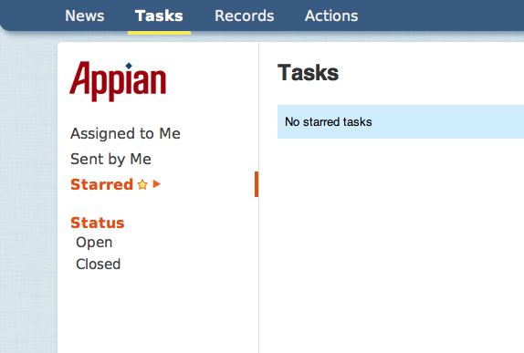
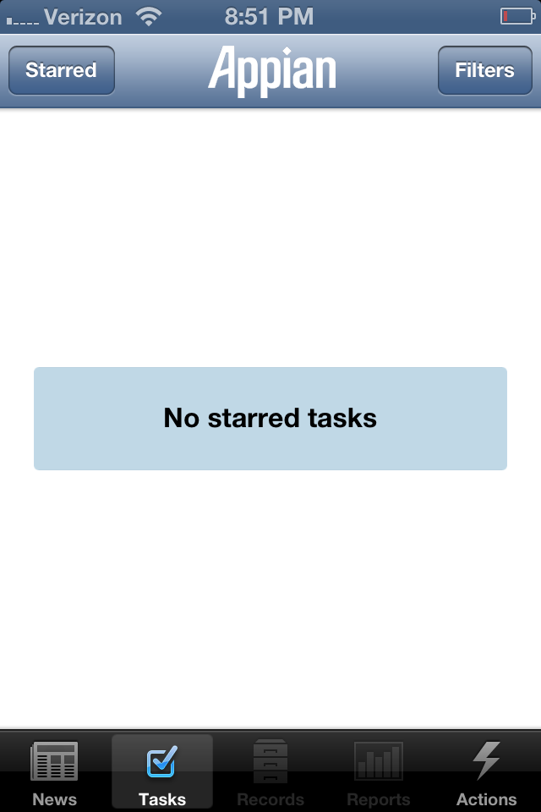
Making it Work
Notes:
Tabs across the top, views are on the left
- We added facets and facet options later. I'll come back to that
- For now let's treat tabs and views as the only elements in our UI schema
Notice how the meaning of a "tab" and a "view" is completely different on an iOS app
- tab bar on the bottom and buttons on the top are easily understood by iOS users, though
- Android does something with tap-and-hold to get a list of views

Slide 8
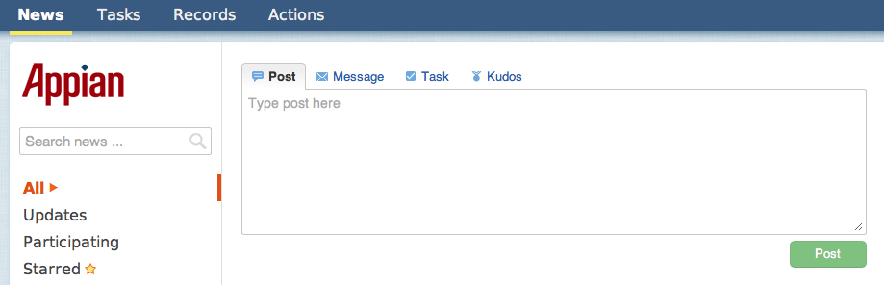
Making it Work
Notes:
We also defined "Things you can create" in this schema
- This box on the web responds to configurations for these entities

Slide 9
Making it Work
step 2: boot your app from a single starting point
Notes:
Now you have an app that is simple enough to build on a bunch of platforms
- You just map your high-level UX features to their platform-specific equivalents
Next, your app has to load its configuration
- I say "app" but I mean mobile or web
- At Appian, it's a GWT client
Start by requesting the top-level configuration from a well known URL
- This should be the only absolute URL your app knows, all others relative

Slide 10
Making it Work
<root>
<tab name="News" default="true" />
<view name="Recent" data="...relativeURL..." default="true" />
<view name="Activity" data="...relativeURL..." />
...
</tab>
...
<entity name="Message" action="...relativeURL...">
...
</entity>
...
</root>
Notes:
This is a simplified look at the data that comes back from that initial request
- We use a JSON format, not XML, but this fits better on a slide
- Notice that it's all just layout. No actual data.
All those relative URL's point to REST services
Cool features of doing things this way
- You can update the behavior of all your clients without deploying a client update
- Server tells all the clients what to display
- You can change what different platforms display via the "Accepts:" HTTP header
- You don't need a lock-step release schedule for your clients
- If one doesn't know what facets are, it ignores the element
Appian needs to maintain forward and backward compatibility (Cloud, mobile and on-premise installs)

Slide 11
Making it Work
step 3: REST requests return UI configurations
Notes:
We used to code views for different clients and have REST calls that returned data only
- The WS data was the model in our MVC
But this isn't very flexible
- Platform-specific views required every time we invent a new feature
- Each required mockups, review by product management, etc
- Not to mention a lot of duplicated logic
Rather than building an MVC for each feature view, one MVC where the model is the view config plus its data
- A view config consists of a tree structure of UI components, each with its bound data
- Each client has its own version of the UI lexicon - VerticalPanel, HorizontalPanel, Label, TextBox, Image, etc.
- Each of those is mapped to the native equivalent (sometimes visually quite different)
This is so much easier to test
- You've got a component renderer and a bunch of components
- each of those has a very finite number of behaviors
Client updates required only when new components are available
Using the "Accepts:" header, the server can control the layout received
Server can hide features that aren't available, even if the client supports them
- this server doesn't have video streaming
- this server is running a trial license

Slide 12
Making it Better
step 4: UI configs have expressions in data bindings
Notes:
Of course, your native mobile apps won't have JavaScript
- Why does this matter? You have much lower-level access
- But rendering UI configs means you can't execute arbitrary code on the client in your UI
- Can't stop someone from entering "hello" in a number field, or even turn the field red
- Can't have state selector appear if you choose USA as country
Expressions in data bindings let you reevaluate your UI state whenever data changes
- data changes can be from user interaction or pushed from the server
Can apply formatting and validation to fields
Can set label values as functions of text field inputs
Can make whole UI blocks visible or invisible based on data state (visible="expr..." on *Panel)
Best of all, the configuration is declarative rather than procedural

Slide 13

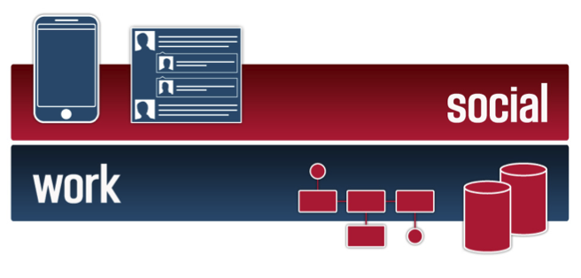
Notes:
This would be a good time to talk about what Appian does
- We help customers run their businesses by automating stuff
- When you applied to college, registered for classes, bought anything online, you were part of a human-machine workflow that could have been orchestrated by Appian
- Customers design the workflow
Customers (not programmers) design the screens you see
- And they work on all browsers and 3+ mobile platforms!
There are other places that automate business processes, but none have native UI's like that
Other key feature is social
- Jive, Yammer and others have tried to be like "Facebook for work" but it doesn't work
- Employees use one system to file TPS reports and Jive to chat about how much the other system sucks
- Unstructured interaction isn't linked to the TPS report
- No ability to search for related communications
We use Appian internally to manage our SDLC, among other things
- We discuss features with the field in the social interface
- Features get linked to sprints
- User stories tracked to master
- Integrated with CI

